Slide 1
Lecture 5 Transfer Learning and GAN
CS 180 – Intelligent Systems
Dr. Victor Chen
Fall 2022

Slide 2
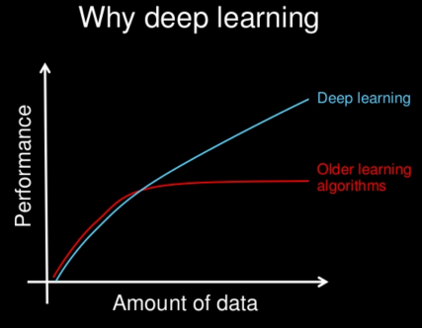
Transfer learning
A large amount of data is required to train good deep learning models
What if you don't have much data on your own task?

Slide 3
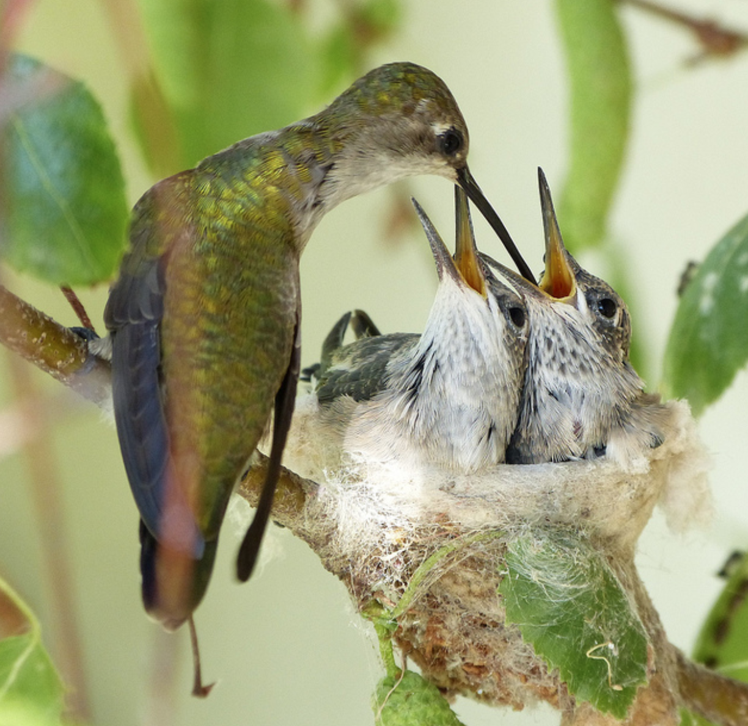
Transfer learning

Slide 4
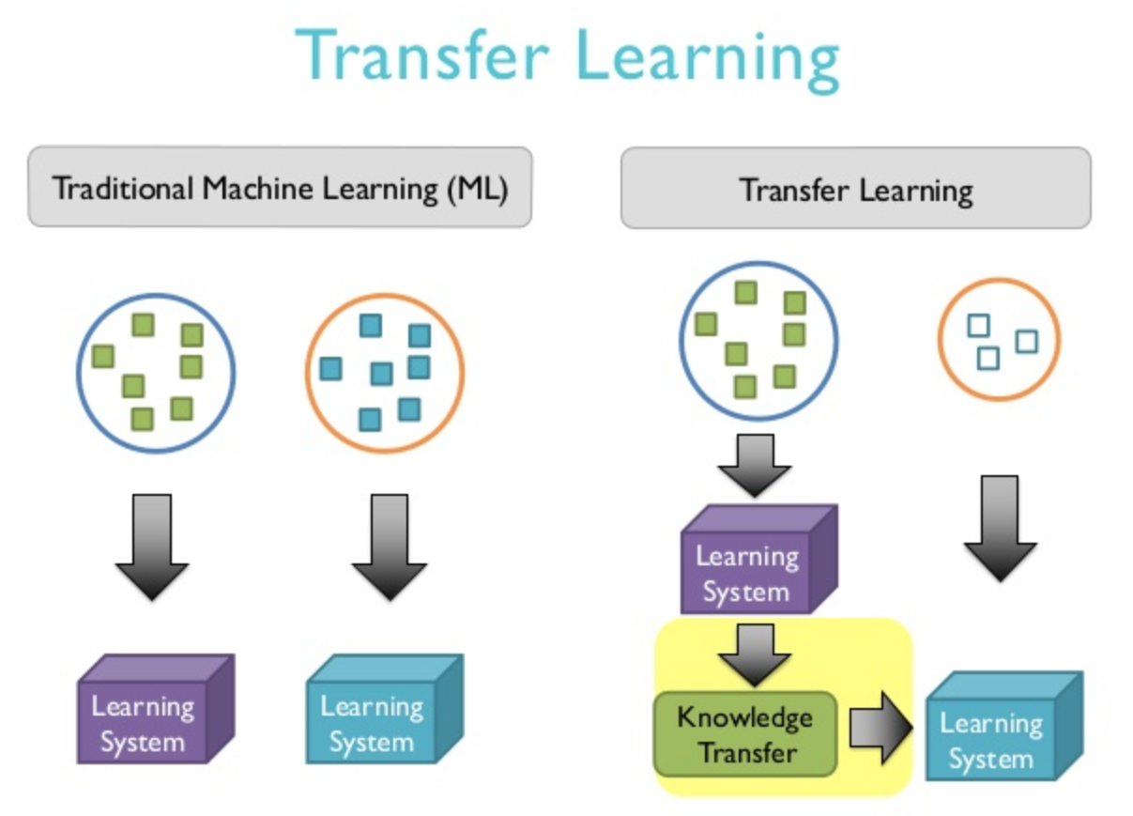
Transfer learning
If you don't have much data on your own task, find a similar task with much data and use transfer learning
In transfer learning, we reuse a model trained on one task for another task.

Slide 5
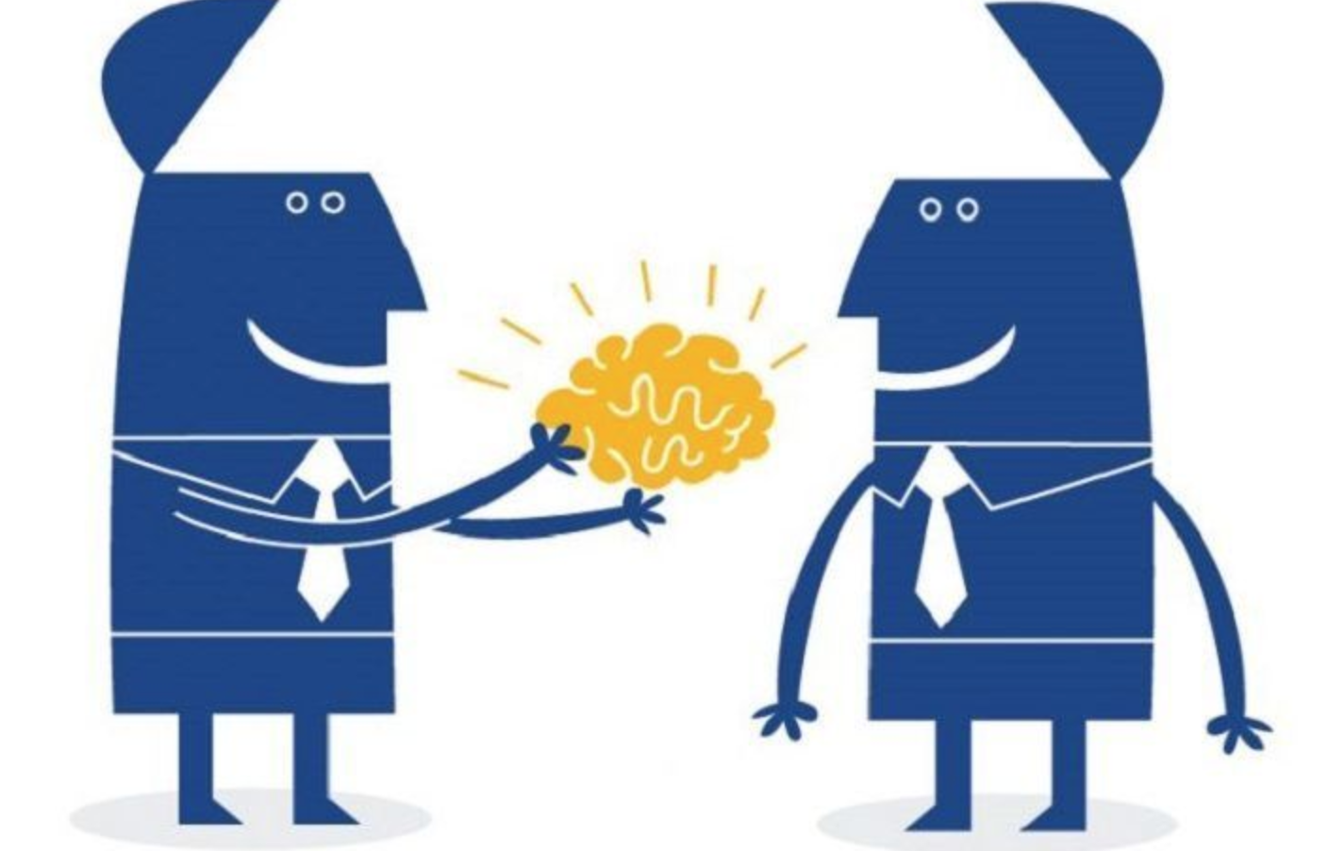
Two basic steps in transfer learning:
Identify a pre-trained model on a different but similar task.
Fine-tune the pre-trained model using your own data.
We refine the pre-trained model to make sure it works for your exact problem

Slide 6
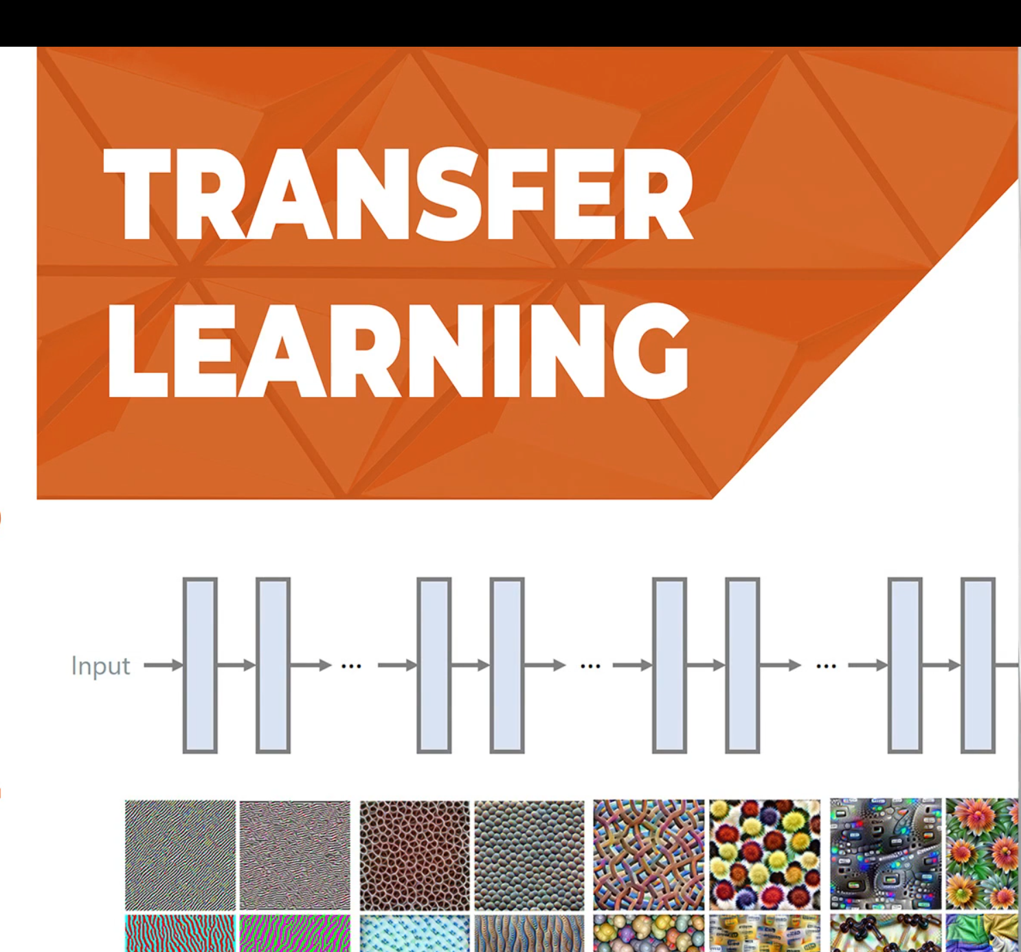
Transfer learning video

Slide 7
How to find pre-trained models
Many research institutions release models pre-trained on large datasets. These models took days or weeks to train on modern hardware.
Pre-trained models on image classification problem
Oxford VGG Model
Google Inception Model
Microsoft ResNet Model
Pre-trained models on natural language processing
Google’s word2vec Model
Doc2vec model
Stanford’s GloVe Model
ELMo
BERT

Slide 8
Pre-trained models in Tensorflow/Keras
https://keras.io/applications/
Models for image classification with weights trained on ImageNet (http://image-net.org/index):
Xception
VGG16
VGG19
ResNet, ResNetV2, ResNeXt
InceptionV3
InceptionResNetV2
MobileNet
MobileNetV2
DenseNet
NASNet

Slide 9
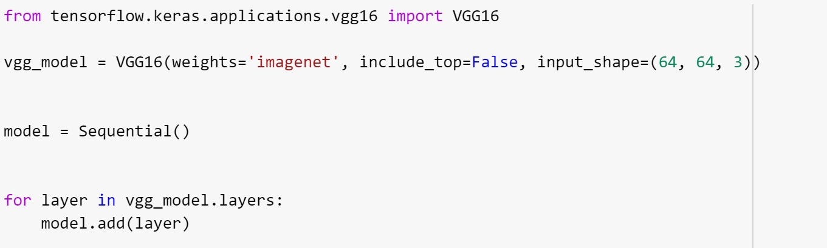
Transfer learning in Tensorflow
Step 1: Load a pre-trained model (except the top layer)

Slide 10
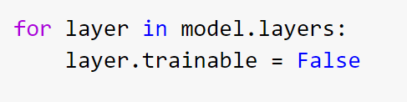
Transfer learning in Tensorflow
Step 2: Fix the weights from the pre-trained model

Slide 11
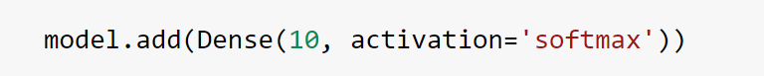
Transfer learning in Tensorflow
Step 3: Add other layers on top of the pre-trained model

Slide 12
Takeaway
Transfer learning is a shortcut to saving time or getting better performance
Use transfer learning if
You don't have much data on your own task but you can identify a related task and there is a pre-trained model available for that task.
Use transfer learning for your final project, which will boost the model performance and save training time

Slide 13
GAN (Generative Adversarial Networks)
Discriminative algorithms try to classify input data; that is, given the features of an instance of data, they predict a label or category to which that data belongs.
Generative algorithms generate new, synthetic data that mimic real data. They are used in image generation, video generation and voice generation.
While discriminative models care about the relation between y and x, generative models care about “how you get x.”

Slide 14
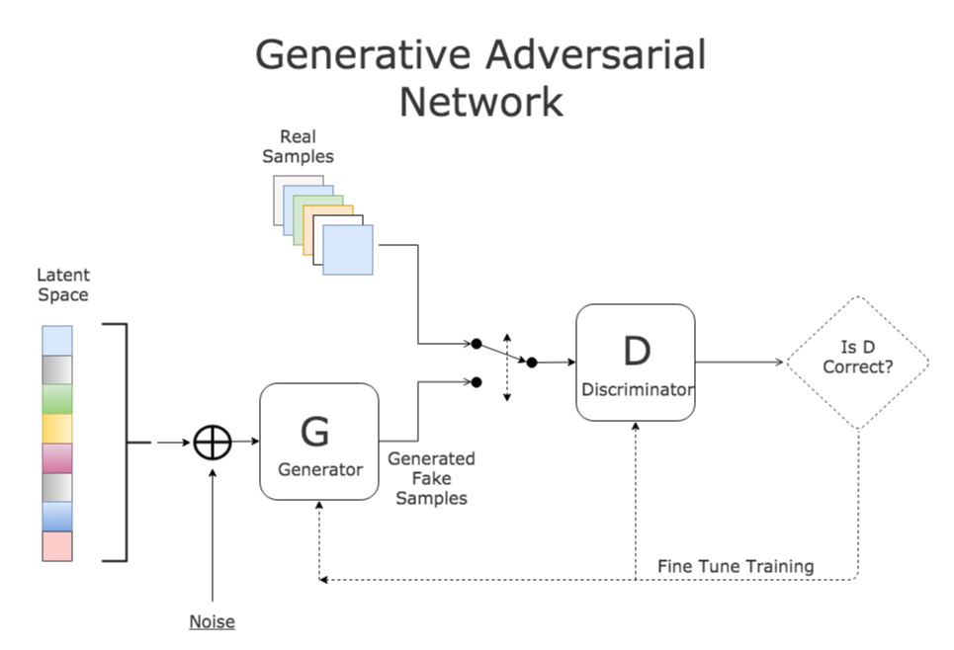
GAN(Generative Adversarial Networks)

Slide 15
GAN Video

Slide 16
DeepFake
https://www.cnn.com/interactive/2019/01/business/pentagons-race-against-deepfakes/

Slide 17
The Next Rembrandt
www.nextrembrandt.com

